Slide 1


Adversary Emulation Framework
Mentors: Dr. Alcides Alvear Suarez & Robel Campbell
Integrants: Kiara Rivera Domenech, Genesis Resto, Carlos Roque
Date: September 19th, 2023

Slide 2
Table of Contents
Command and Control Framework (C2) and Structure Diagram context
Project Improvements: PE Loading, Module Stomping
Diagrams: Implant Execution Part 1 and 2
References
Q&A
G. Resto, K. Domenech, C. Roque Adversary Emulation Framework
2

Slide 3

Project Context
G. Resto, K. Domenech, C. Roque Adversary Emulation Framework
3

Slide 4

Command and Control Framework
Dynamic Evasion – Variable Syscalls, ETW/AMSI Patching
In-memory Execution – Download Cradles, Microcontroller
Encrypted Payloads – AES-256, XOR
G. Resto, K. Domenech, C. Roque Adversary Emulation Framework
4

Slide 5
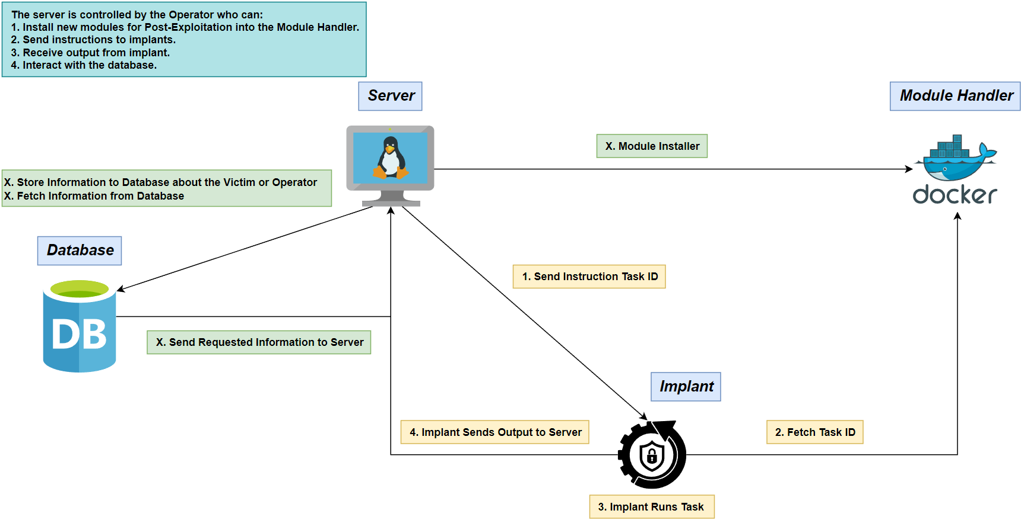
Structure Diagram
G. Resto, K. Domenech, C. Roque Adversary Emulation Framework

Slide 6
Project Improvements
G. Resto, K. Domenech, C. Roque Adversary Emulation Framework

Slide 7
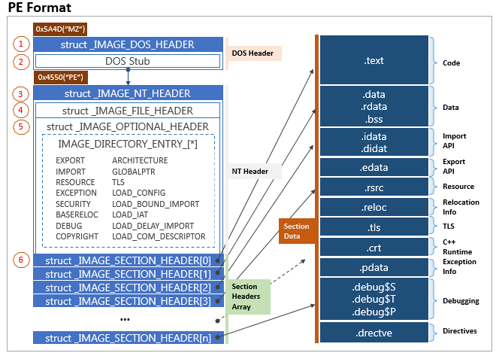
PE Loading

Slide 8

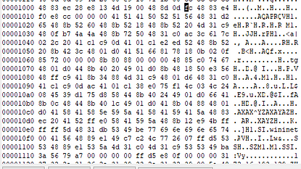
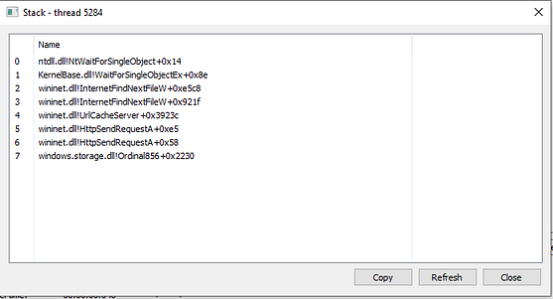
Module Stomping

Slide 9
Diagrams

Slide 10
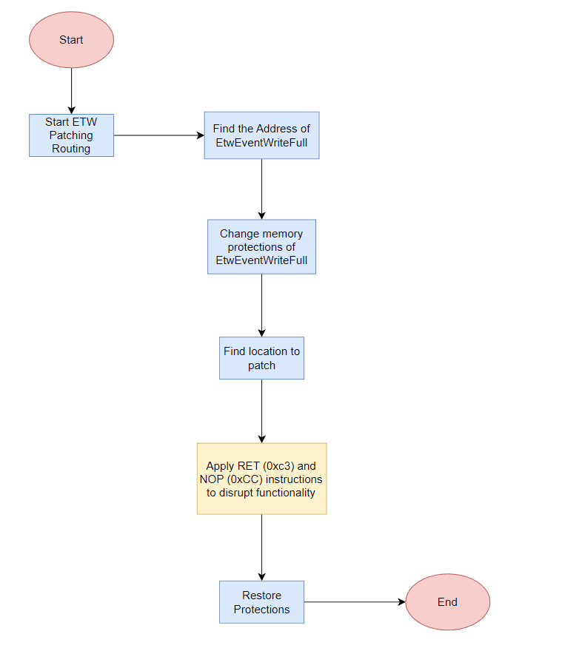
Implant Execution Step 1
G. Resto, K. Domenech, C. Roque Adversary Emulation Framework

Slide 11
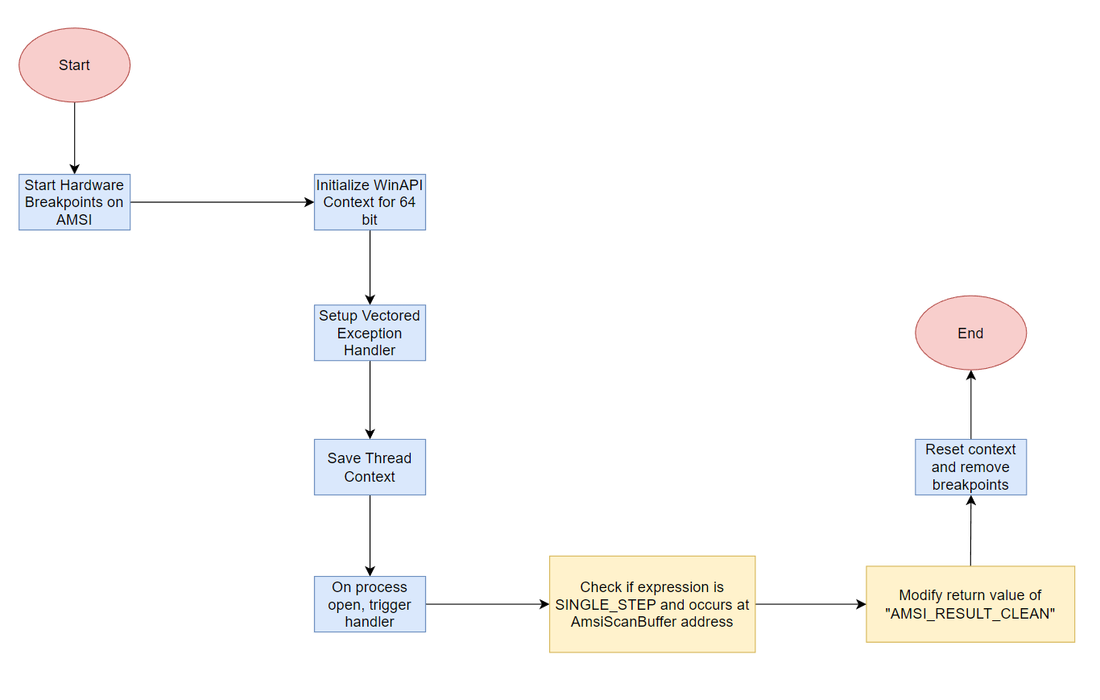
Implant Execution Step 2
G. Resto, K. Domenech, C. Roque Adversary Emulation Framework

Slide 12
References
Microsoft (2023, August). Antimalware Scan Interface (AMSI). Microsoft Learn. https://learn.microsoft.com/en-us/windows/win32/amsi/antimalware-scan-interface-portal
Microsoft (2021, December). Event Tracing for Windows (ETW). Microsoft Learn. https://learn.microsoft.com/en-us/windows-hardware/drivers/devtest/event-tracing-for-windows--etw-
G. Resto, K. Domenech, C. Roque Adversary Emulation Framework
12

Slide 13

Thank you

